Slide 1
Engineering Design DSN2096

Slide 2
Syllabus
Introduction to Engineering design process: Design History; Dieter Rams Principles of Good Design; Overview of Engineering Design Process: Problem Formulation, Concept generation, Project Planning and Design Making; Human Centred Design (HCD);
Design Thinking for Innovation: Design Thinking as Mindset, Process and Toolbox., Enhancing Design Thinking Through, Empathy, Interviewing, Questioning & Brainstorming, Tools for Design Thinking: Mind Mapping, Innovation Flowchart – Question ladder – SCAMPER (for products) Journey Mapping, Task analysis grid (for services)
Engineering Design Approaches: Professional and societal Context of Design; Different types of design – Conceptual, Embodiment designs and Detailed designs – Identification and Specifications, Standards and codes, Design Features – Design for Aesthetics, Production, Standards, Minimum risk, Ease of maintenance, Quality, Minimum cost and Optimum Design, Service Design - People - Asserts - policies - culture. Iterative process - Exploration - Creation - Reflection - Implementation.

Slide 3
Syllabus
Usability & Reliability: Usability – User requirement; User experience; Usability testing; Customer Co-creation; Reliability & Safety: Human and equipment, safety, Risk analysis, and security, System reliability; Use of e-engineering: Modelling, Simulation and Verification.
Prototyping and Visualization: Design Cycle Model, Metaphor method: Theory and methodology of concept generation, Blend method & Thematic Method. Conceptual Design & Design capability and sociality. Prototyping & Visualization Design Tools – E-tools
Sustainable Design: Concepts of sustainable development, Sustainable design principles - Design for Environment; Life Cycle Assessment; Models of sustainable design- Biomimicry, Eco Design, Recycling; Social Innovation
Communication: Articulating design ideas: Storytelling; Sketching & Dynamic Diagrams; K Scripts

Slide 4
Books and resources
TEXT BOOKS:
Huge Jack, “Engineering Design, Planning, and Management” Academic Press, 2013.
Gerhard Pahl, Wolfgang Beitz “Engineering Design: A Systematic Approach” 2014.

Slide 5
Let’s start with some problems

Slide 6

Challenger Disaster

Slide 7
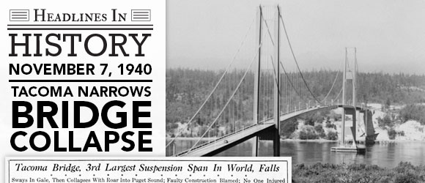
Tacoma Bridge Collapse

Slide 8
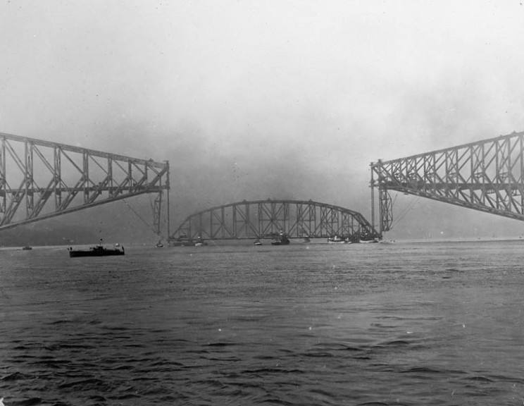
Collapse of The Quebec Bridge

Slide 9
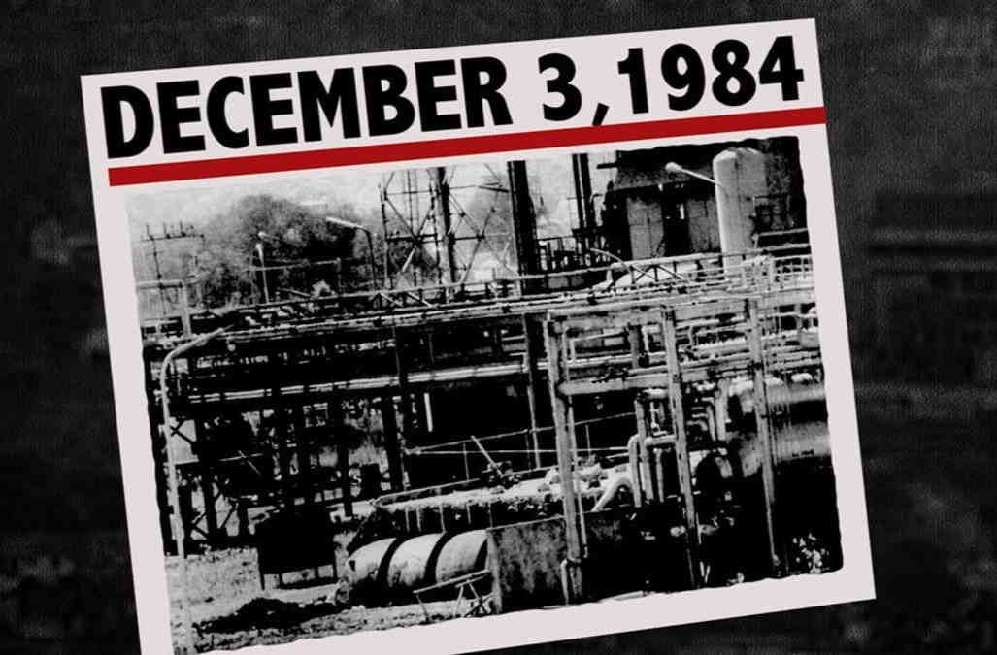
Bhopal Gas Tragedy

Slide 10
Why do we need good design?

Slide 11

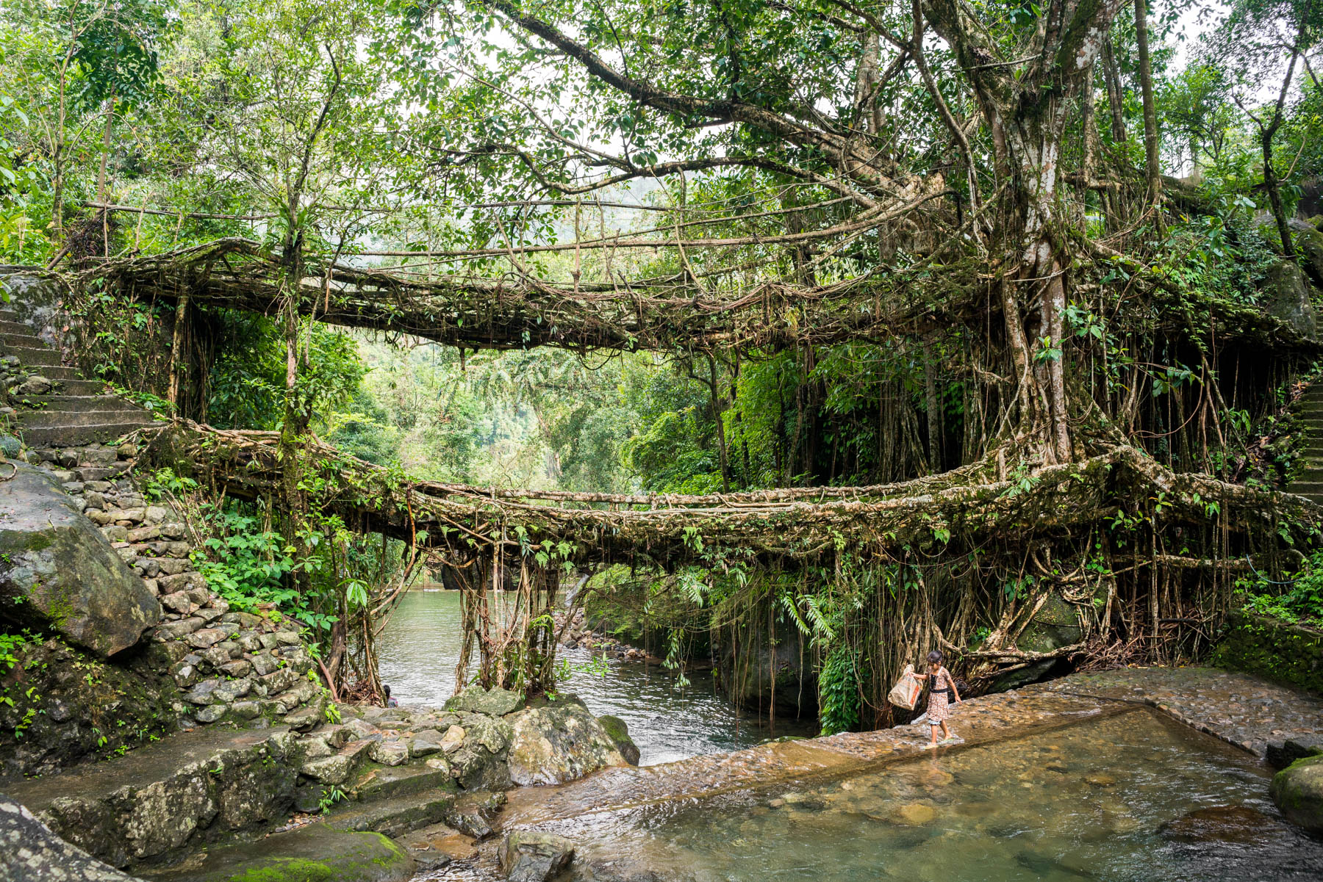
Design by Nature

Slide 12
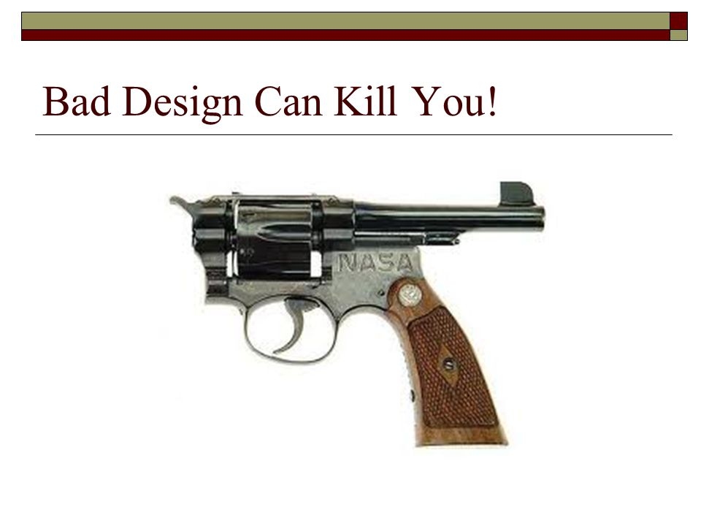
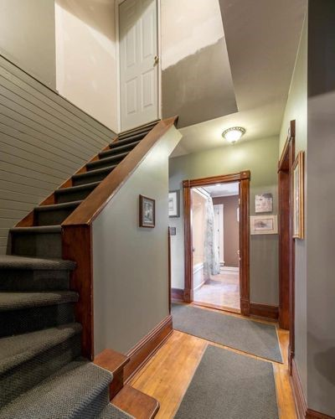
Bad/Flawed Design

Slide 13
Dieter Rams’ Principles of Good Design
Good Design Is Innovative
Good Design Makes a Product Useful
Good Design Is Aesthetic
Good Design Makes A Product Understandable
Good Design Is Unobtrusive
Good Design Is Honest
Good Design Is Long-lasting
Good Design Is Thorough Down to the Last Detail
Good Design Is Environmentally Friendly
Good Design Is as Little Design as Possible

Slide 14
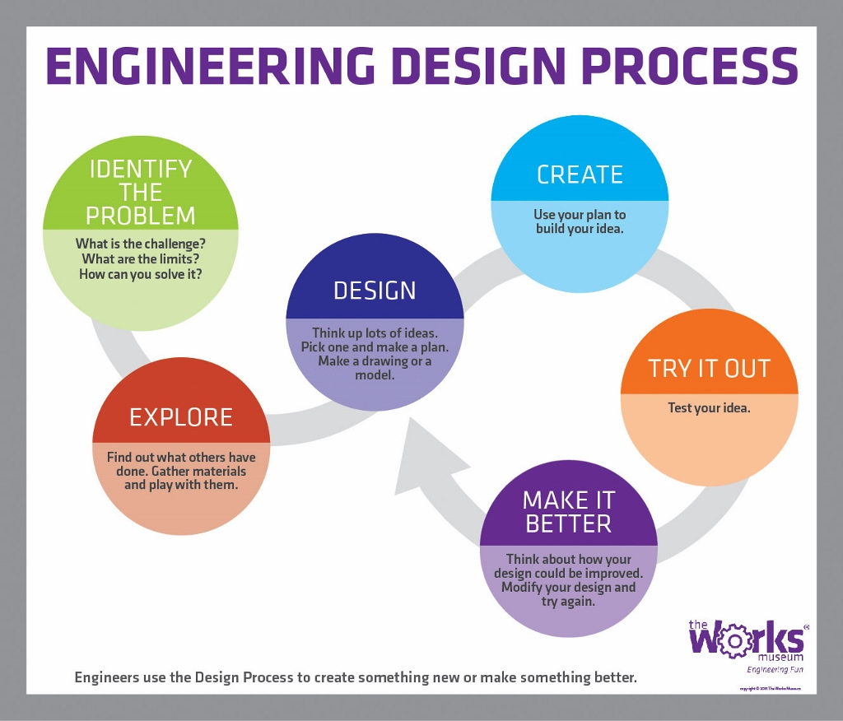
Engineering Design Process

Slide 15
Engineering Design Process
Engineering design is the method that engineers use to identify and solve problems. It has been described and mapped out in many ways, but all descriptions include some common attributes: Engineering design is a process. This powerful approach to problem solving is flexible enough to work in almost any situation.

Slide 16
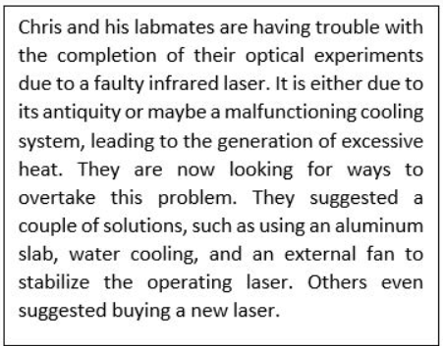
Engineering Design Cycle: True or False Activity
This activity will help you assess your knowledge of the steps in the engineering design of a product.
Directions
Based on the given scenario, determine whether the following statements are true or false. To do this, print or copy this page on a blank paper and underline or circle the answer.

Slide 17
True | False 1. The steps that Chris and his colleagues would undertake to solve their problem are called the engineering design cycle.
True | False 2. They should determine whether the problem originated from the laser's antiquity or its damaged cooling system.
True | False 3. Once they've identified the problem, the next step would be to brainstorm for solutions.
True | False 4. A brainstorming process produces a vast array of ideas and draws links between them to find potential solutions.
True | False 5. Placing an aluminium slab under the laser equipment is not a possible solution.
True | False 6. From the possible solutions, their team should decide which solution to develop.
True | False 7. A prototype that works with some minor setbacks needs no redesigning.
True | False 8. Their team decides to make an external fan using readily-available materials to serve as the final model.
True | False 9. Chris may continue the step-by-step design process until the problem is officially solved.
True | False 10. If they decide to redesign the prototype, they should consider brainstorming all over again.

Slide 18
Answer Key
True
True
False, because the correct statement is: Once they've identified the problem, the next step would be to look for existing solutions.
True
False, because the correct statement is: Placing an aluminum slab under the laser equipment could be a possible solution.
True
False, because the correct statement is: A prototype that works with some minor setbacks needs redesigning.
False, because the correct statement is: Their team decides to make an external fan using readily-available materials to serve as the prototype.
True
True

Slide 19
Problem Formulation
Recognizing the Need:
Identify the Client:
Do we know who this is
Do they know what their “need” is
Gathering the Client Needs:
Interviews
Questionnaires
Focus Group
Be the customer
Recognizing the Need:
Rules for interacting with the client:
1. Keep a broad perspective
2. The client may pose a Potential Solution and not their original need. Hence, as a designer, you may lose scope of that need and head in the wrong direction from the start.
3. Always ask why when someone says “I need”

Slide 20
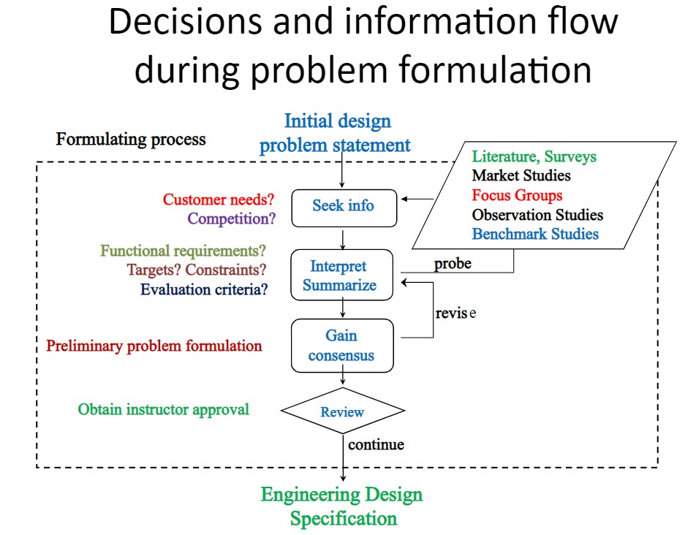
Problem Formulation

Slide 21
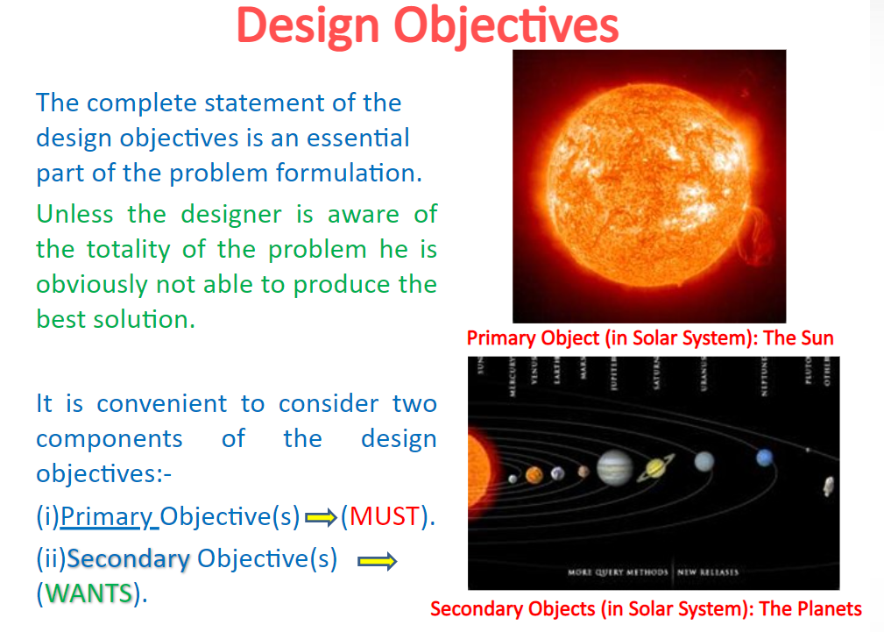

Slide 22
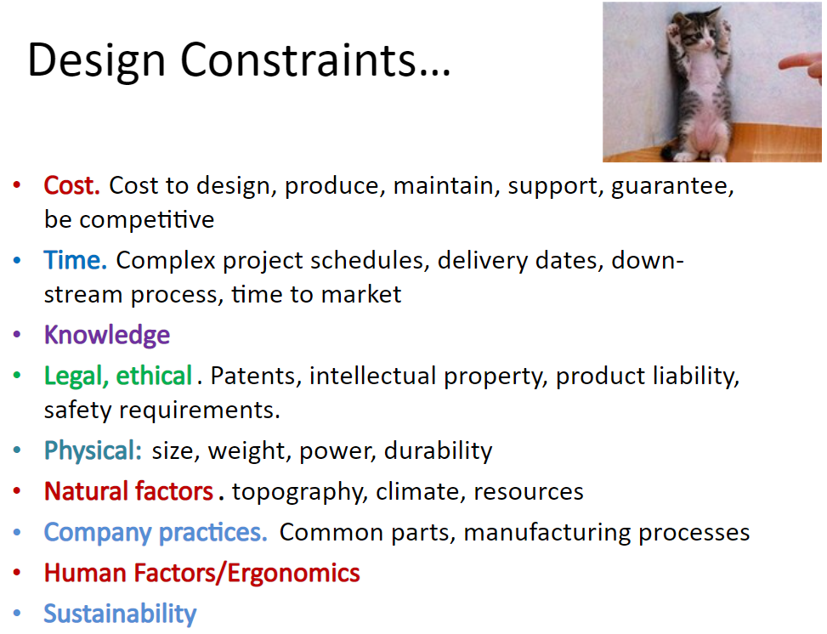

Slide 23
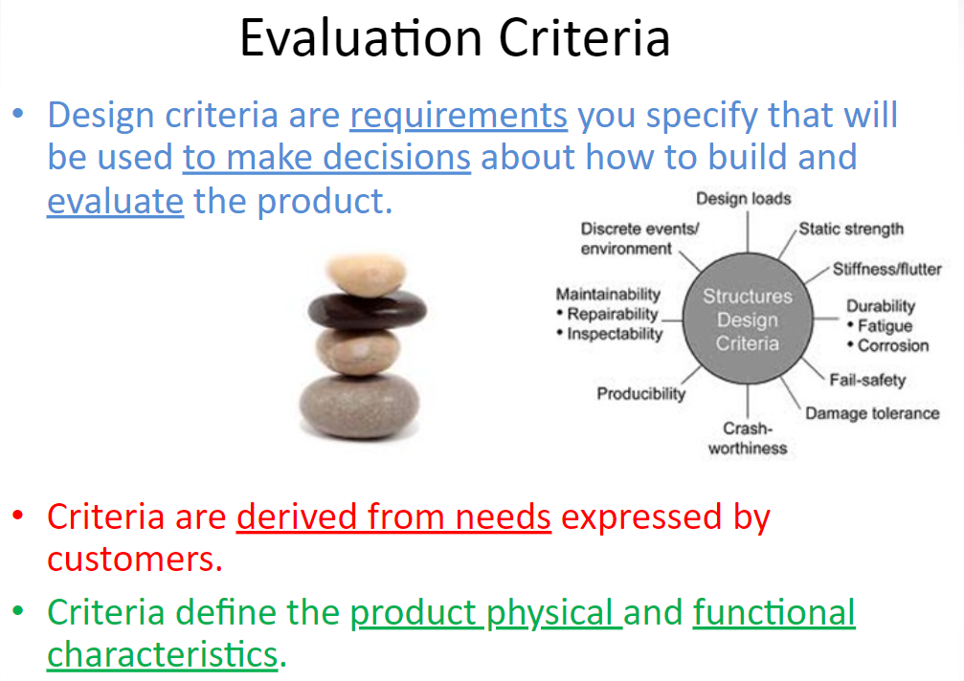

Slide 24
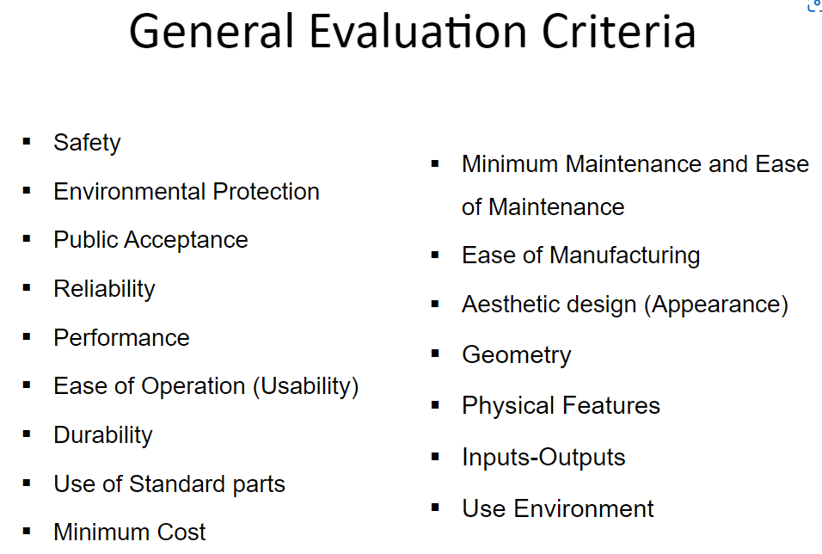

Slide 25
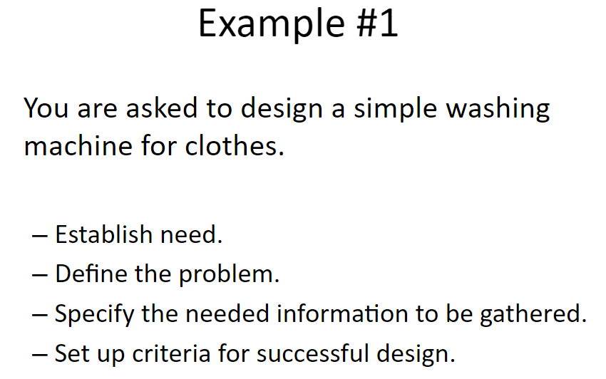

Slide 26
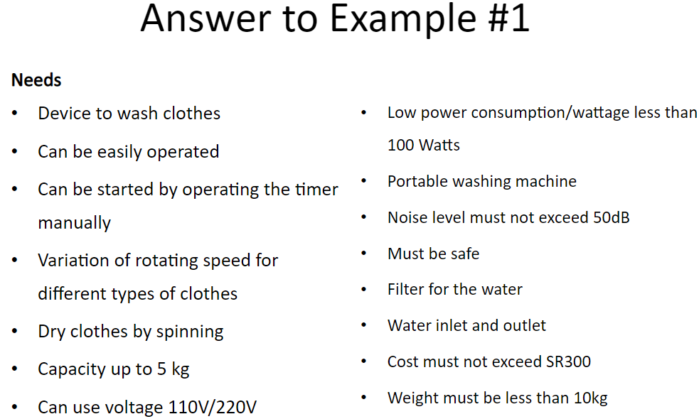

Slide 27
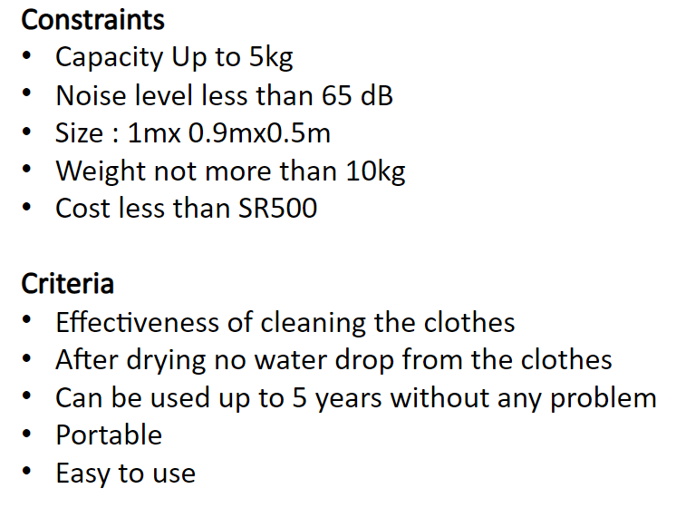

Slide 28
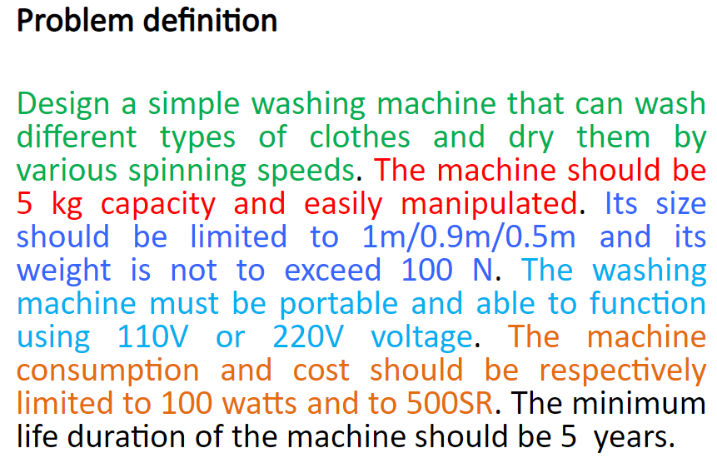

Slide 29
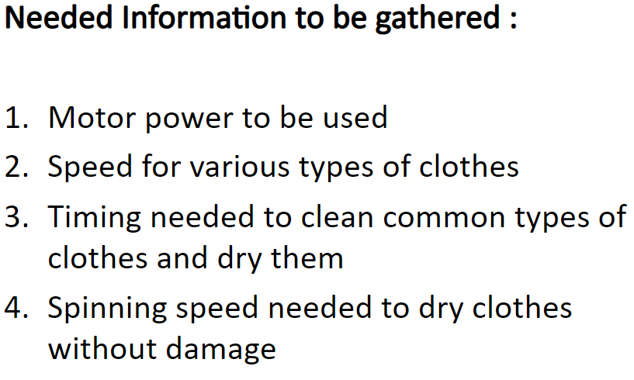

Slide 30
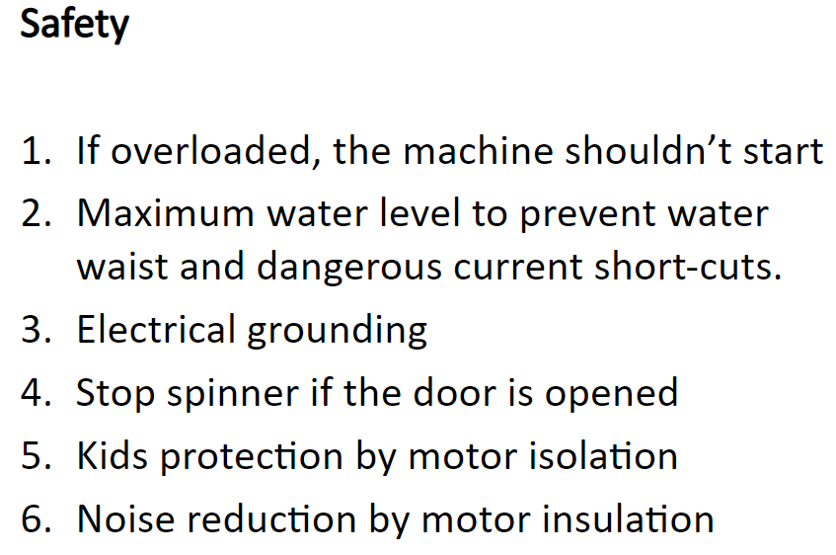

Slide 31
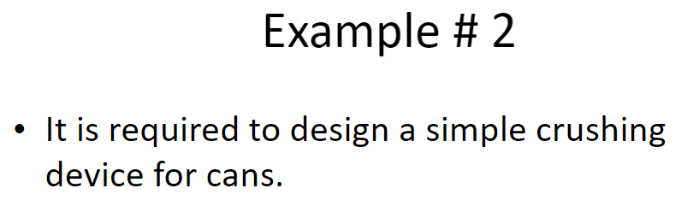

Slide 32
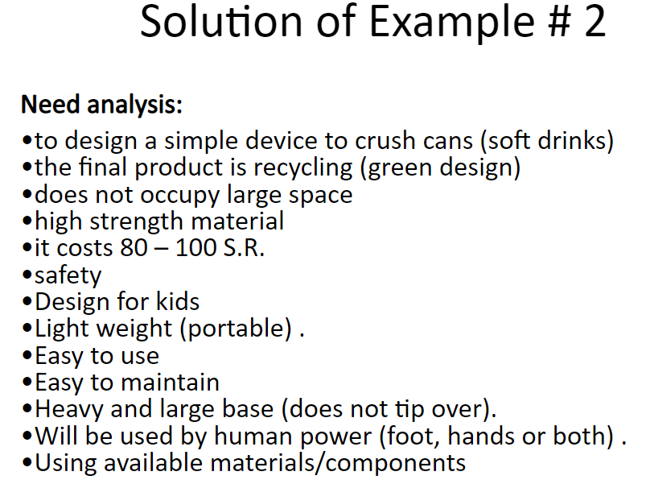

Slide 33
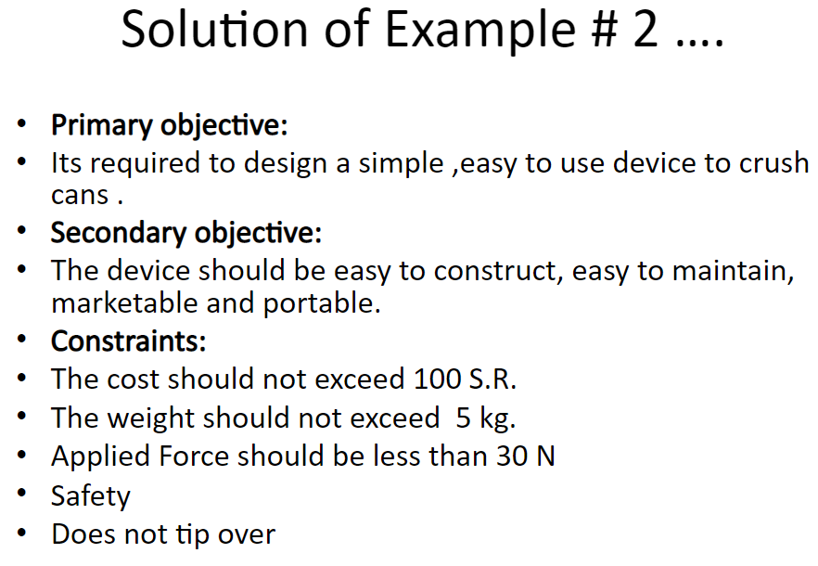

Slide 34
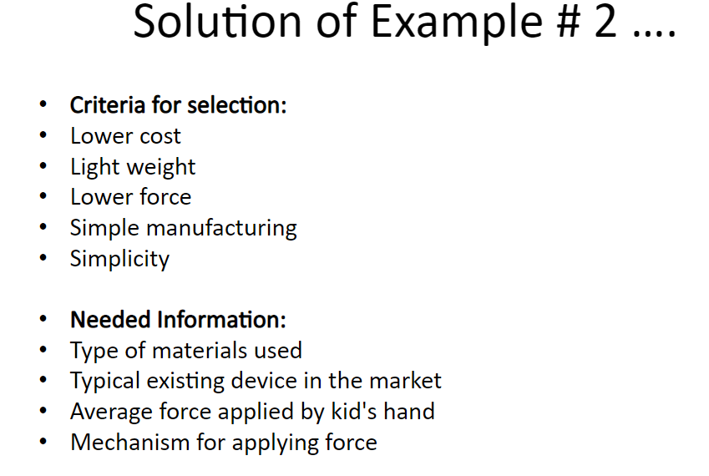

Slide 35
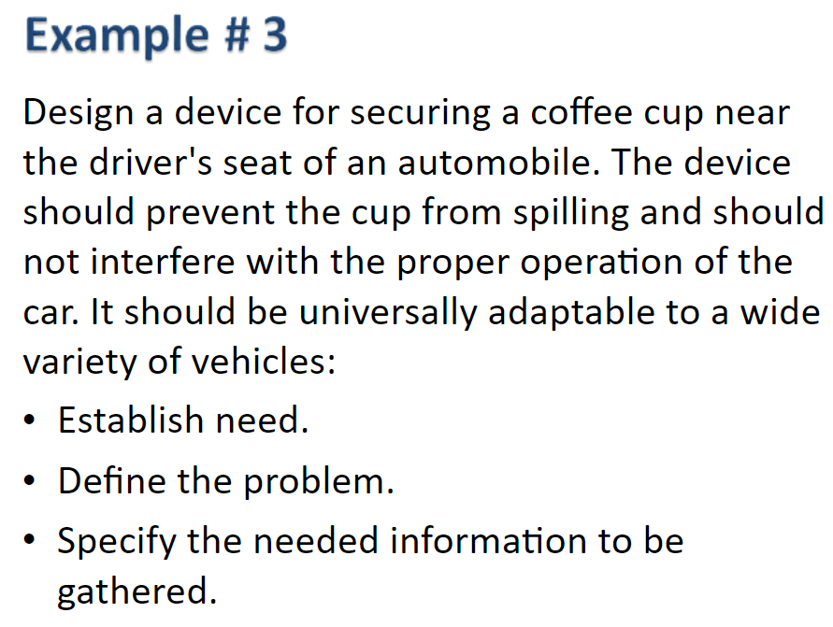

Slide 36
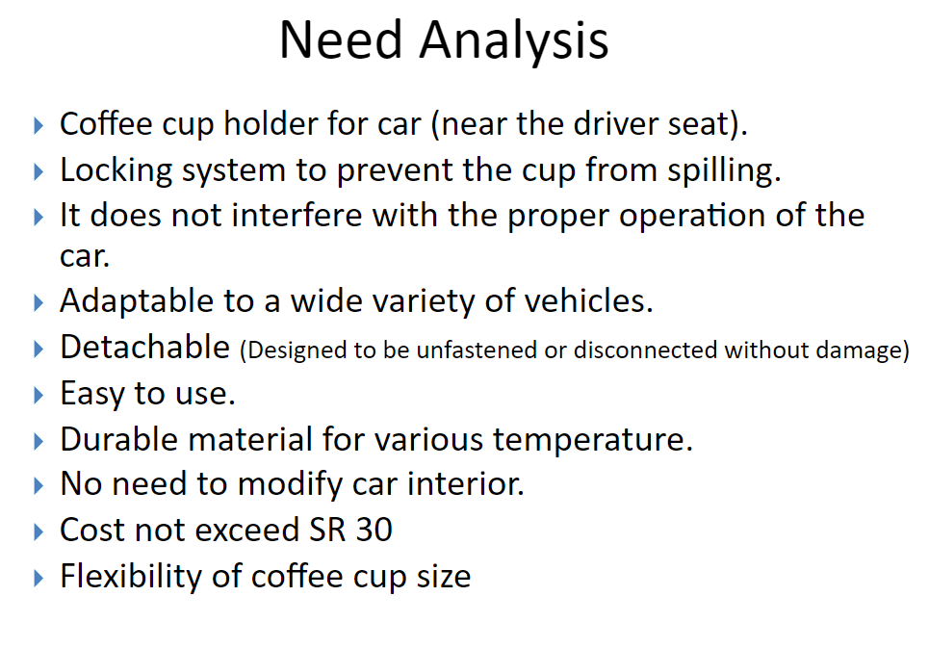

Slide 37
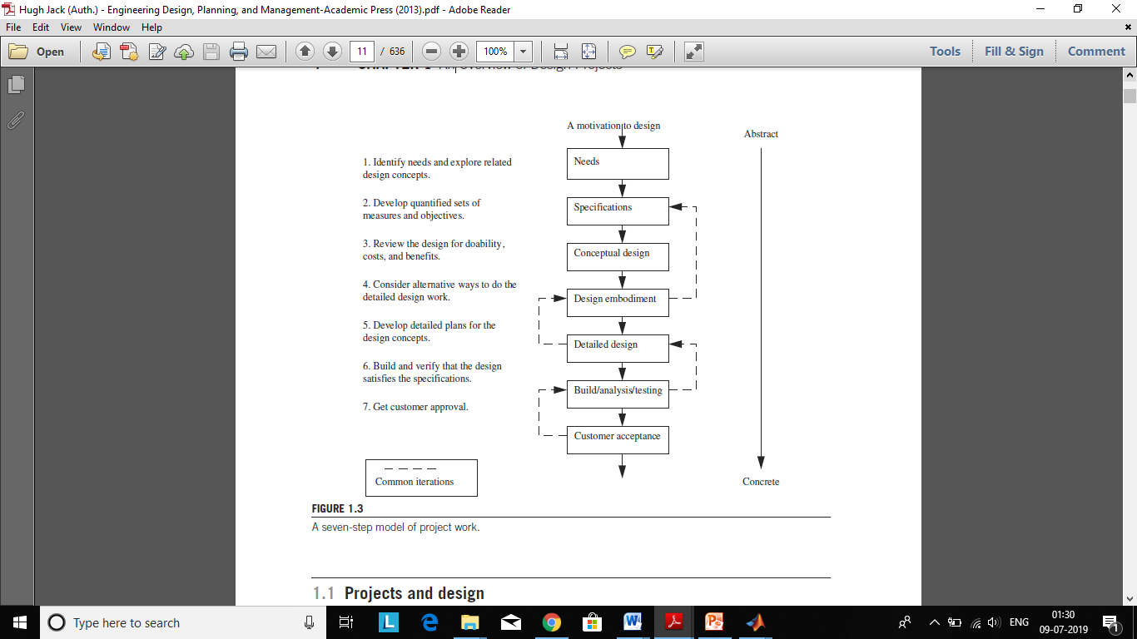
A seven-step model of project work.

Slide 38
Project Planning
Project planning is the process of defining your objectives and scope, your goals and milestones (deliverables), and assigning tasks and budgetary resources for each step.

Slide 39
Project Planning: 7 Keys
Think of your plan as a roadmap for stakeholders
Break the project into a list of deliverables
Talk to your team
Identify risks
Create a budget
Add milestones
Set progress reporting guidelines
S: Specific
M: Measurable
A: Acceptable
R: Realistic
T: Time Based

Slide 40
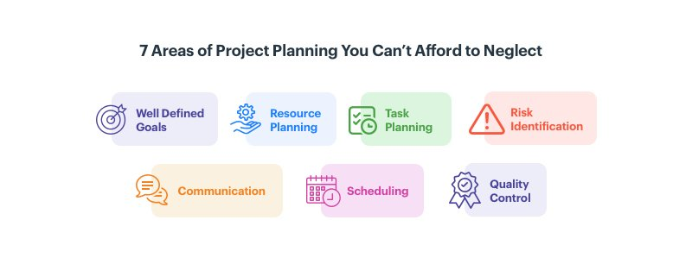

Slide 41
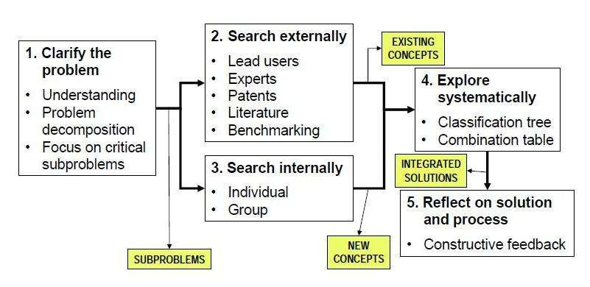
Concept Generation Process

Slide 42
Project Planning & Management
The project manager is responsible for creating, tracking, and revising the plan. However, the process of planning should include multiple groups and people, typically called stakeholders, or sometimes the audience.
The planning process has multiple steps including
(1) Breaking the project into a set of tasks,
(2) Developing a list of approvals and milestones,
(3) Itemizing required resources,
(4) Checking the plan for consistency.
The plan often includes a schedule for tasks and time, a budget for money,
and a communication list.

Slide 43
Human Centred Design
Human Centered Engineering Design (HCED) is concerned with the interactive, iterative, and creative problem solving and/or product and system development by building empathy with the customer to better understand their needs.
The human centered design approach is widely being adopted by different industries, including automotive, aerospace, healthcare, information technology, software, consumer electronics, e-commerce, and digital marketing.
These industries are actively looking for design professionals with the technical background who can research, identify, translate and document user needs; generate creative product/process design ideas that address user requirements; and implement and evaluate the usability of products or services in a scientific way.
Human Centered Engineering Design is an interdisciplinary and inclusive field of study that bridges engineering design, art design, social sciences and business principles.

Slide 44
Thanks!

